Slide 1

Digital Twin of a Rotating Shaft for Predictive Maintenance using MATLAB Simulink and Simscape
MDM2104 – Case Study: Intelligent Systems in Production
Group 9
Sameer K. Subair
Karthik Gopi
Nihal Sait Nishan
Abdul Rashid Kundladi
Notes:
“This project focuses on building a digital twin of a rotating shaft system to enable predictive maintenance. We use MATLAB Simulink and Simscape to model the physical system and apply a machine learning pipeline to predict failures early. The goal is to reduce unplanned downtime and maintenance costs in industrial rotating machinery.”
❓ Possible Questions & Answers
Q: What is a digital twin? A: A digital twin is a virtual replica of a physical system that continuously updates using real-time data to monitor health and predict failures.
Q: Why rotating shafts? A: Rotating shafts are critical components in motors and turbines, and failures can cause huge downtime losses.

Slide 2
Outline
Problem Statement
Results & Validation
References

Slide 3
Industrial Problem & Motivation
• Problem: Rotating shafts in industrial machinery develop mechanical faults that increase vibration and can cause unexpected breakdowns.
• Why it matters: Unplanned failures lead to downtime, higher maintenance cost, and potential secondary damage to connected components.
• Failure modes: Imbalance, misalignment, bearing degradation, looseness, and resonance effects near critical speeds.
• Goal: Create a physics-based digital twin in MATLAB Simulink and Simscape to reproduce shaft dynamics, monitor vibration signatures, and support predictive maintenance decisions.

Slide 4
Objectives & Scope
• Objective 1: Develop a physics-based digital twin of a rotating shaft system using MATLAB Simulink and Simscape.
• Objective 2: Generate virtual sensor signals (vibration, torque, speed) under healthy and degraded conditions
• Objective 3: Extract time- and frequency-domain indicators to detect fault signatures and support predictive maintenance.
Scope / Assumptions
• Predict Remaining Useful Life (RUL) using a data-driven model trained on simulated lifecycle data
• Visualize health index, degradation severity, and predicted RUL through a monitoring dashboard

Slide 5
System Architecture
• Physical model: Actuation gain drives an inertia–damping shaft model with a fixed mechanical reference.
• Sensing: Virtual measurements of angular speed, shaft torque, and a vibration-related signal derived from the mechanical response.
• Data layer: Logged simulation outputs exported to the MATLAB workspace for post-processing and comparison across test cases.
• Analytics: Time- and frequency-domain analysis using indicators such as RMS and FFT peak components. Monitoring dashboard displaying health, severity, and predicted RUL
• Visualization: Monitoring dashboard displaying health, severity, and predicted RUL

Slide 6
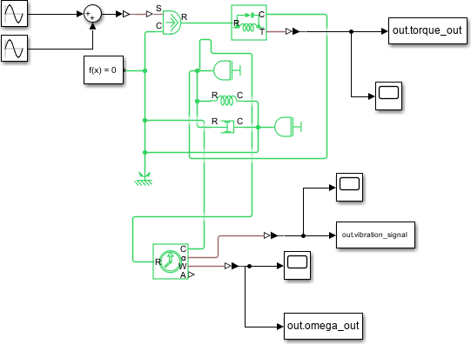

Slide 7
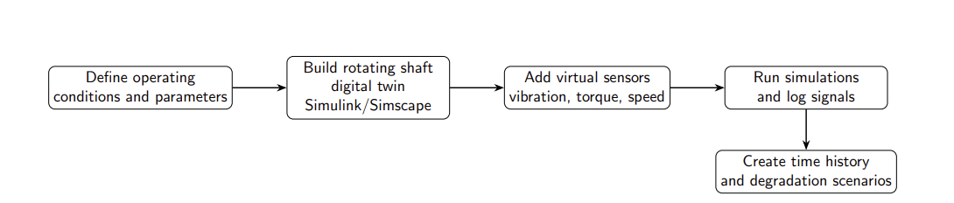
Modelling Flow: Digital Twin and Data Generation
Outcome: sensor-like time series generated from the physics-based model for prognostics.

Slide 8
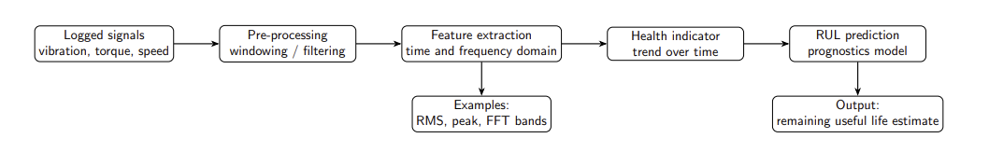
Modelling Flow: Feature Pipeline and RUL Prediction
Outcome: a degradation-aware pipeline that produces an RUL estimate from digital-twin signals.

Slide 9
Simulation Setup
Operating conditions
• Speed: constant operating speed set in the Simulink model.
• Simulation time / sample rate: fixed-step simulation with signals logged at a uniform sampling interval for analytics.
• Sensors: vibration signal, shaft torque, and angular speed from virtual sensors.
Data generated for prognostics
• Baseline run to establish nominal feature values.
• Degradation run to generate a time history used for health trend estimation and RUL prediction.

Slide 10
Feature Extraction for Prognostics
• Sensor signals are segmented into fixed-length windows and processed per window.
• Time-domain features: RMS vibration, peak-to-peak amplitude, crest factor, kurtosis.
• Frequency-domain features: FFT magnitude at dominant components and band-energy measures in selected frequency ranges.
• The resulting feature vector is tracked over time to build a health trend and estimate remaining useful life.

Slide 11
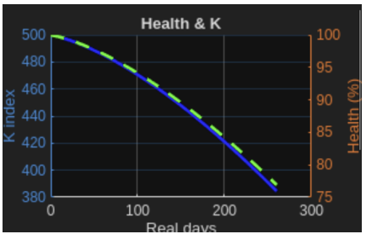
Health Indicator and Degradation Trend
• A normalized health index is derived from the extracted features using the healthy baseline as reference.
• The health index is evaluated continuously to quantify the degradation trend over operating time.
• Degradation is generated by progressively injecting fault severity in the model, producing a declining health index used for RUL estimation.

Slide 12
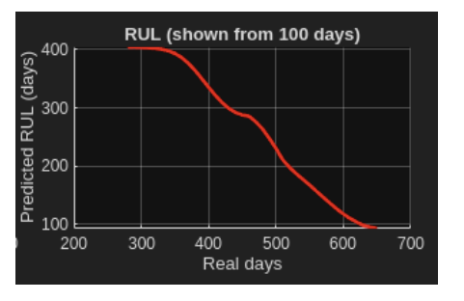
RUL Prediction Results
• RUL is predicted by a trained BiLSTM-attention model using the most recent 30-day feature history.
• The estimate is updated sequentially as new feature windows are generated from the digital twin signals.
• Results are reported as an RUL trend over operating time and a current RUL value for maintenance planning.

Slide 13
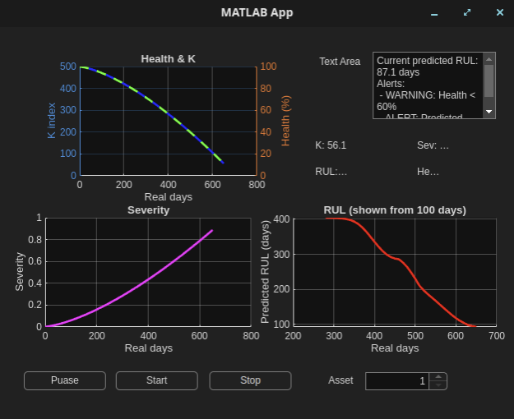
Monitoring Dashboard for Prognostics

Slide 14
Monitoring Dashboard for Prognostics
• A MATLAB App Designer dashboard is used to monitor the digital twin outputs in a single view.
• Live plots display the health index, fault severity progression, and predicted RUL over time.
• Control buttons allow the user to start, pause, and stop the simulation and updates.
• The health index trend provides an immediate interpretation of degradation, showing how the system deviates from the healthy baseline.
• The severity plot visualizes the injected degradation profile, enabling direct correlation between fault growth and changes in the health index.
• The RUL plot highlights how the estimate stabilizes or shifts as more data becomes available, reflecting the confidence of the prognostics pipeline.
• A status panel reports the current RUL estimate and issues warnings when degradation accelerates or when the health index approaches the end-of-life threshold

Slide 15
Discussion: Interpretation of Outputs
• Progressive fault injection produces a systematic rise in vibration features, which is reflected as a clear degradation trend in the health index.
• Normalization against the healthy baseline converts raw signal changes into an interpretable health scale, enabling consistent comparison across runs.
• Variations in the RUL curve indicate the sensitivity of prediction to recent degradation rate, and a stabilizing RUL trend suggests steady degradation behavior.
• The combined view of severity, health index, and RUL links root cause, current condition, and expected remaining life for maintenance planning.

Slide 16
Discussion: Sensitivity and Uncertainty
• Degradation profile sensitivity: the RUL estimate is primarily driven by the injected severity trajectory; a change in fault growth rate directly changes the slope of the health index and the predicted end-of-life time.
• Feature sensitivity: features with strong response to severity produce a cleaner, more monotonic health trend; weak or noisy features increase scatter and lead to unstable RUL updates.
• Noise and variability: measurement noise increases short-term fluctuations in the health index, which propagates into RUL oscillations; smoothing improves stability but reduces responsiveness.
• Windowing trade-off: shorter windows improve update rate, while longer windows improve robustness; the selected window length determines the balance between latency and confidence.
• Confidence in predictions: prediction confidence increases when severity, health index, and RUL evolve consistently over time; abrupt changes indicate uncertainty or a regime change.

Slide 17
Limitations and Deployment Considerations
• Model fidelity: the Simscape model is a simplified representation and may not capture all real effects such as nonlinear contact, detailed bearing dynamics, and structural flexibility.
• Degradation modelling: degradation is introduced by controlled parameter changes; real machines may degrade through multiple mechanisms and not strictly monotonically.
• Sim-to-real gap: field data contains sensor noise, mounting effects, temperature influence, and machine-to-machine variability that can shift extracted features.
• Deployment needs: consistent sensor placement and calibration, reliable data logging, robust pre-processing, and periodic re-calibration of model parameters and thresholds using real data.

Slide 18
Conclusions & Future Work
Conclusions
• A physics-based rotating-shaft digital twin was developed in MATLAB Simulink/Simscape and instrumented with virtual sensors.
• Vibration-derived features were used to construct a health index that tracks degradation under progressive fault injection.
• The health trend was converted into an online RUL estimate and visualized through an interactive monitoring dashboard.
Future work
• Integrate real-time data streaming and automate health/RUL updates for continuous monitoring.
• Extend the framework to additional degradation mechanisms and validate RUL performance across multiple operating regimes.

Slide 19
References
[1] R. Raja Singh, Ghanishtha Bhatti, Dattatraya Kalel, Indragandhi Vairavasun-daram, and Faisal Alsaif. Building a digital twin powered intelligent predictivemaintenance system for industrial ac machines. Machines, 11(8):796, 2023. doi:10.3390/machines11080796.
[2] Dong Zhong, Zhelei Xia, Yian Zhu, and Junhua Duan. Overview of predictivemaintenance based on digital twin technology. Heliyon, 9:e14534, 2023. doi: 10.1016/j.heliyon.2023.e14534.
[3] Rui Zhao, Ruqiang Yan, Zhenghua Chen, Kezhi Mao, Peng Wang, and Robert X.Gao. Deep learning and its applications to machine health monitoring. Mechanical Systems and Signal Processing, 115:213–237, 2019. doi: 10.1016/j.ymssp.2018.05.050
[4] Fei Tao, Haoyang Zhang, Ang Liu, and Andrew Y. C. Nee. Digital twin in indus-try: State-of-the-art. IEEE Transactions on Industrial Informatics, 15(4):2405–2415,2019. doi: 10.1109/TII.2018.2873186.
[5] Werner Kritzinger, Matthias Karner, Georg Traar, Jan Henjes, and Wilfried Sihn.Digital twin in manufacturing: A categorization and literature review. ProcediaCIRP, 72:34–39, 2018. doi: 10.1016/j.procir.2018.03.055
[6] Michael Grieves. Digital twin: Manufacturing excellence through virtual factoryreplication. White Paper, Florida Institute of Technology, 2014.

Slide 20
Thank You

